Slide 1
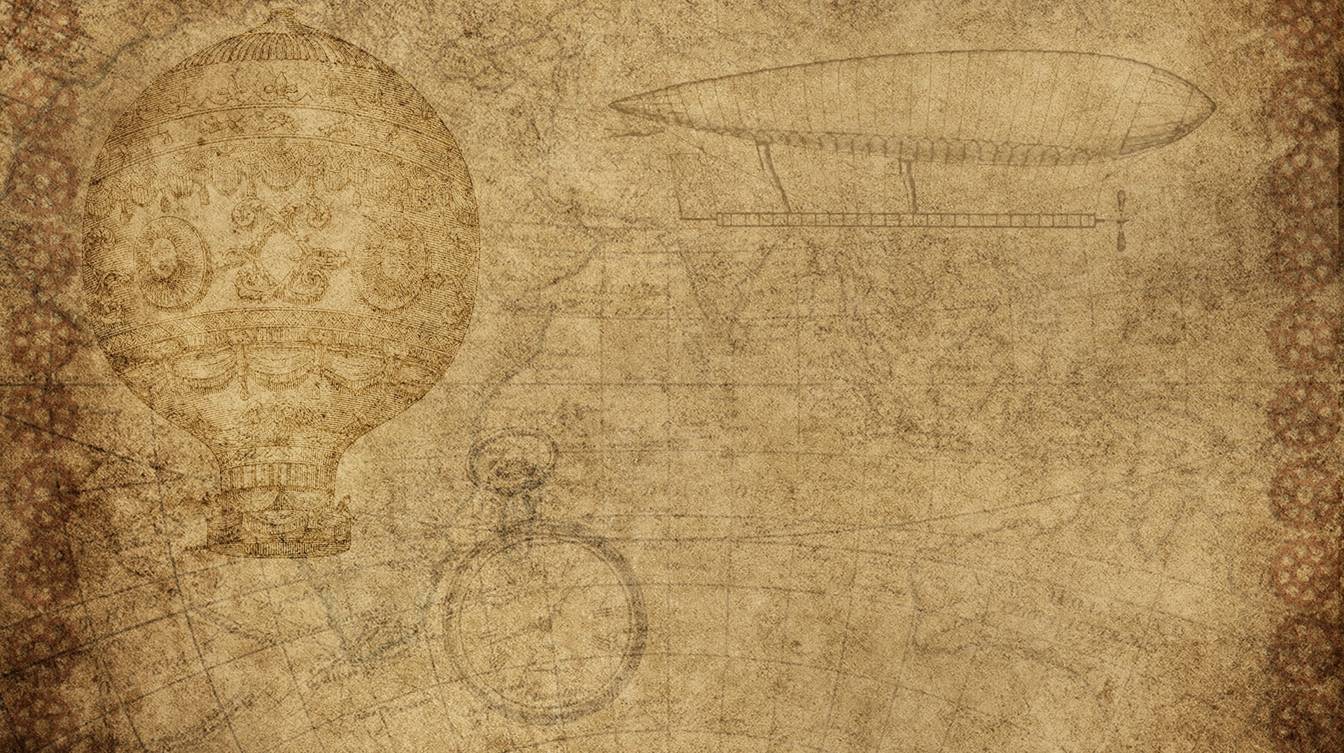

IMAGE COMPRESSION USING C++
DEVANSH MISHRA 2021679
MENTOR : Dr tanupriya choudhury

Slide 2

INTROduction
Image compression reduces the size of an image file without significantly degrading its quality.
Essential for reducing storage space and transmission bandwidth.
Widely used in various applications like web images, digital photography, and video streaming.

Slide 3

METHODOLOGY
Overview of K-Means Clustering:
- Unsupervised learning algorithm.
- Partitions data into k clusters based on feature similarity.
Steps in Image Compression Process:
- Initialize cluster centers.
- Assign each pixel to the nearest cluster center.
- Recalculate cluster centers.
- Iterate until cluster centers stabilize.

Slide 4

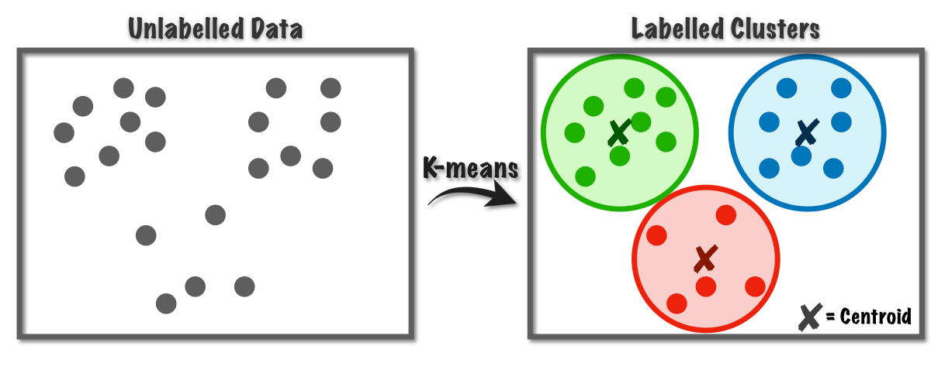
K means clustering algorithm
Initialization:
Randomly select k cluster centers from the image pixels.
Assignment:
Calculate the Euclidean distance between each pixel and cluster centers.
Assign each pixel to the nearest cluster center.
Update:
Compute the mean of pixels assigned to each cluster.
Update cluster centers to the computed mean.-
Iteration:
Repeat the assignment and update steps until convergence.

Slide 5


IMPLEMENTATION
Tools Used:
C++ for programming.
OpenCV library for image processing.
CMake for build automation.
Key Functions:
Euclidean Distance Calculation:
Measures similarity between pixel colors.
New Cluster Centers:
Assigns pixels to nearest cluster centers.
Finding Centroids:
- Recalculates cluster centers as the mean of assigned pixels.

Slide 6
CONCLUSION AND FUTURE WORK
Conclusion:
- K-means clustering is an effective method for image compression.
- Balances compression ratio and image quality.
- Provides flexibility in the number of colors used in the image.
Future Work:
- Explore advanced clustering techniques like hierarchical clustering.
- Implement real-time image compression applications.
- Enhance algorithms for different image formats and resolutions.
- Optimize computational efficiency for large-scale images.

Slide 7
THANKYOU
BY: DEVANSH MISHRA

